Slide 1
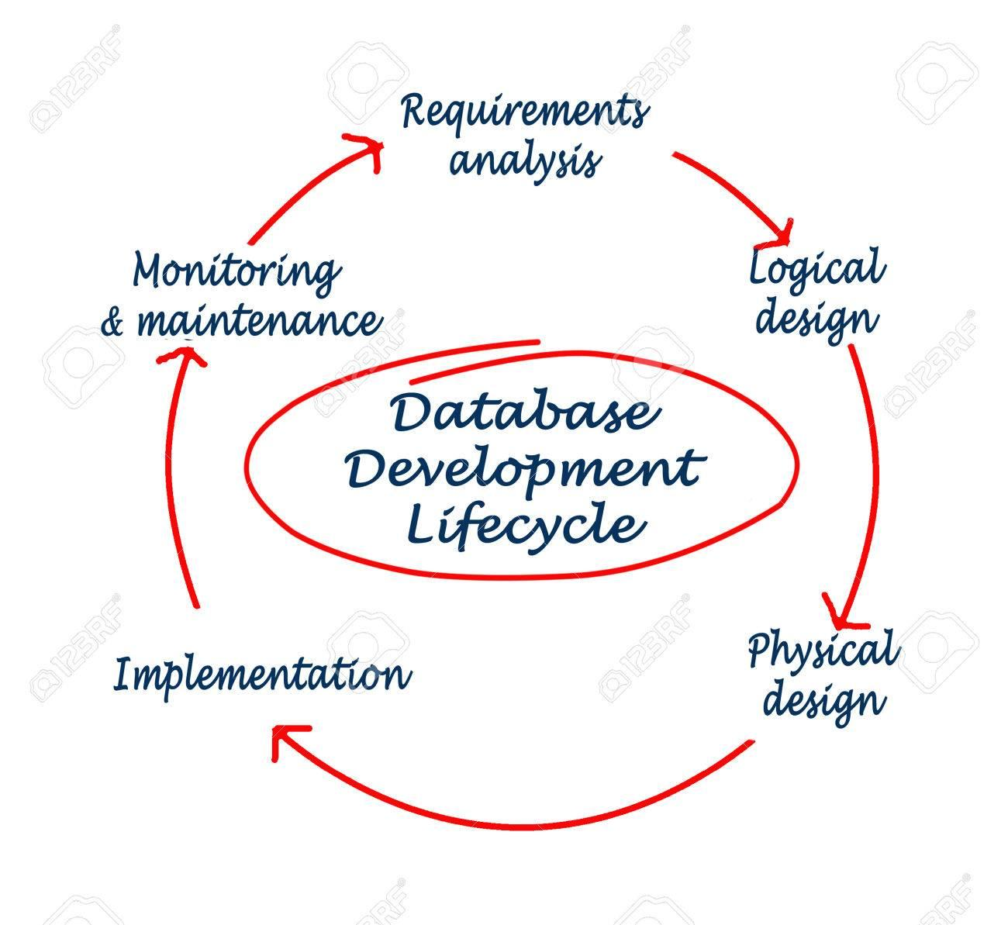
Database Design Best Practices
Determine the purpose of your database.
Find and organize the information required.
Divide the information into tables.
Turn information items into columns.
Consistency (of datatypes, naming standards etc.)
Specify primary keys and Set up the table relationships
Apply the normalization rules to reduce data redundancy.
Performance: when and how to apply indexes, how to write efficient queries etc.
When and how to use different DB objects like views, procedures, functions, triggers.

Slide 2
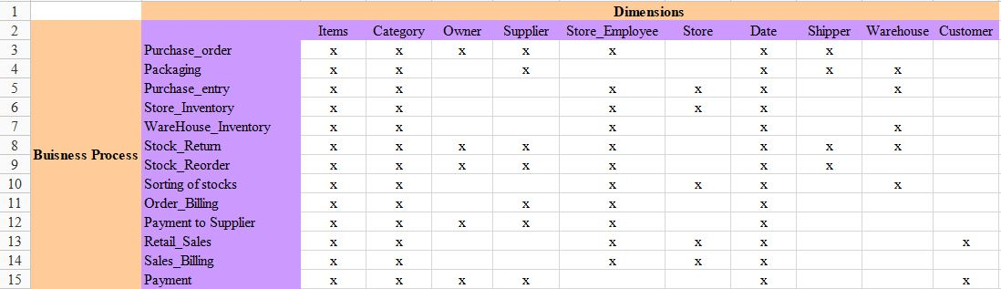
Bus Matrix
Understanding business requirements and determining the business process & dimensions involved in the system under consideration.

Slide 3
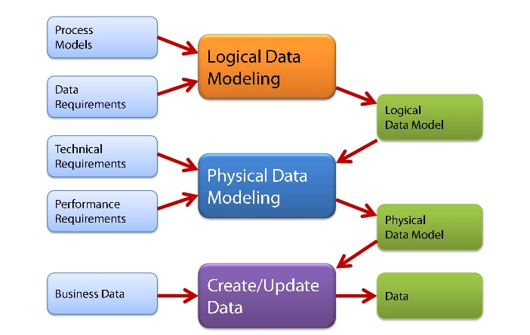
Data Model
Logical structure of the database and data flow between different data elements.
How data is connected to each other and how they are processed and stored.

Slide 4
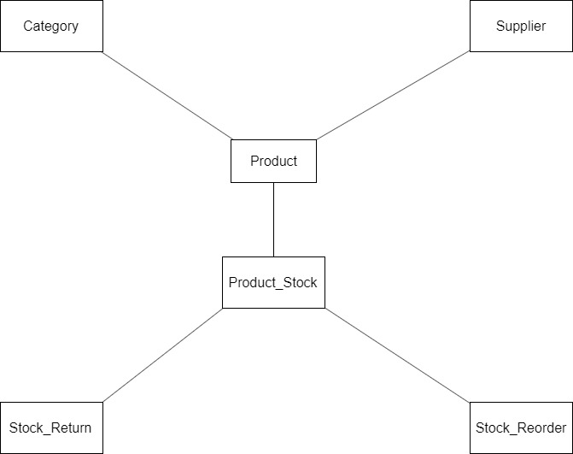
Conceptual Data-Model

Slide 5
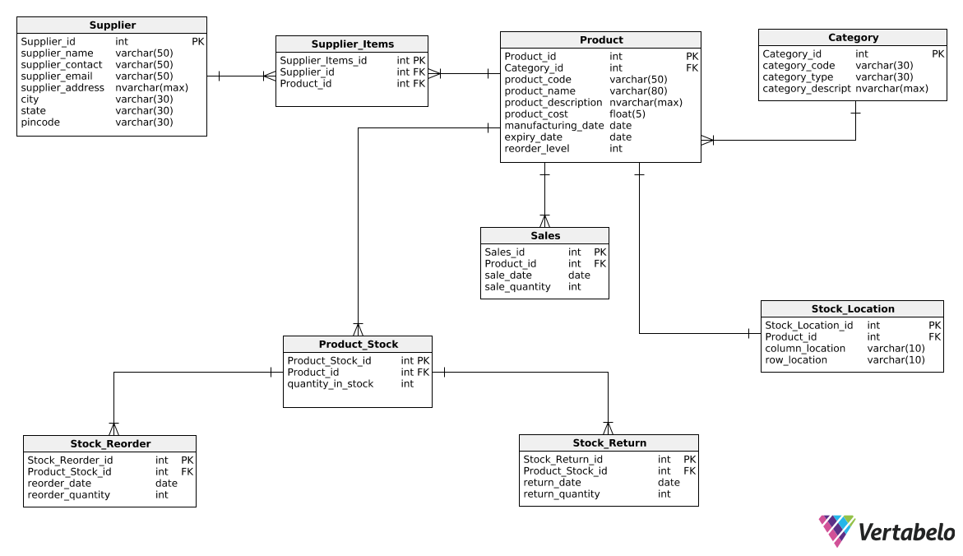
Logical Data Model

